Slide 1
Project SpringWater
Scrum Master: C Boucher
Development Team: C Walker, C Cooper, A Butcher, D Woodward, T Stacey, J Forster & G Westwater

Slide 2

Initial Investigation
NB Gardens
Traditional Catalogue Company
Interviews
Senior Management
Lower Level Employees
Architect the Business

Slide 3

Why are we here?
OPS: Order Placement System
Customer Orders
Web Front End
IMS: Inventory Management System
Managing Stock Levels
Adding Products
Java Desktop App

Slide 4
As a visitor I want to be able to enter my details so I can become a customer
As a visitor I should be able to browse though a list of products
As a customer I want to be able to check my credit
As a customer I want to be able to place an order for the items in my basket
As an inventory manager I want to see the daily stock report
As an inventory manager I want to be able to make purchase orders of low and new stock lines

Slide 5
Database Design

Slide 6
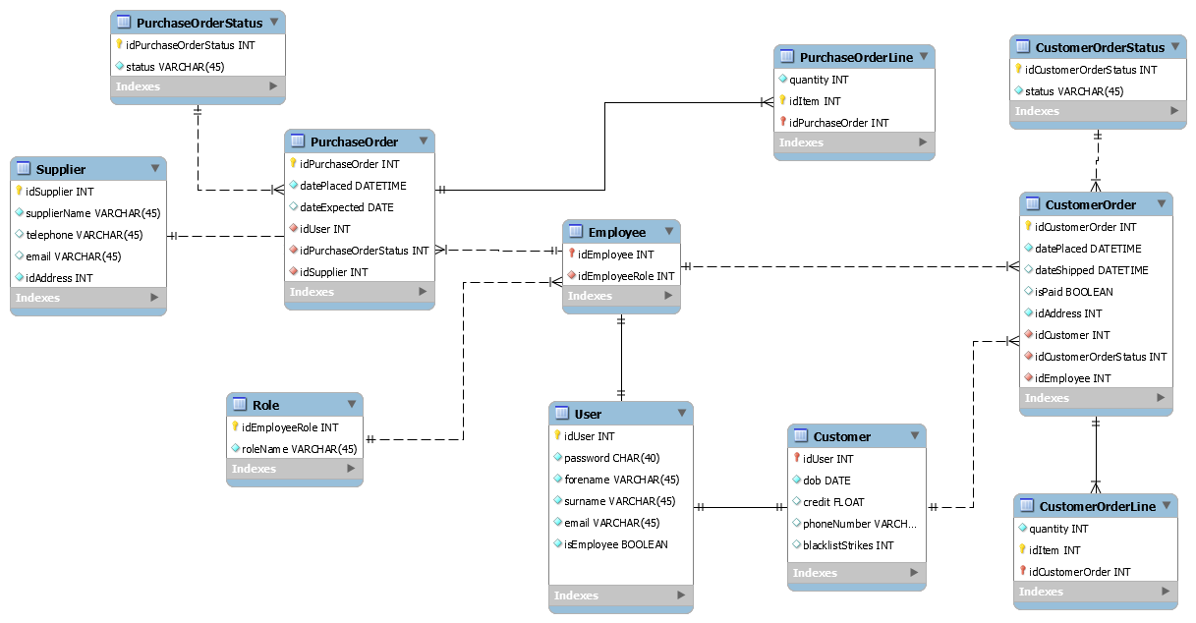
ERD: Entity Relationship Diagram

Slide 7
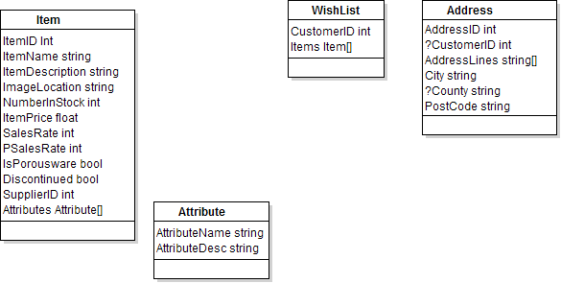
ERD: Entity Relationship Diagrams

Slide 8
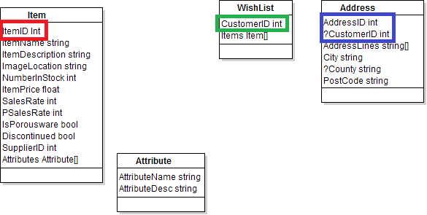
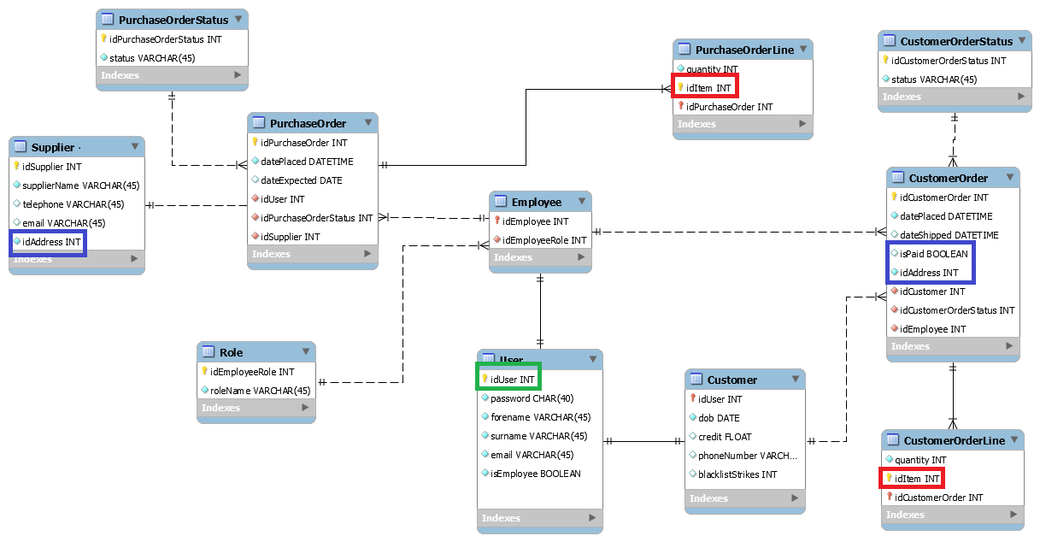
ERD: Entity Relationship Diagrams

Slide 9
System Design

Slide 10
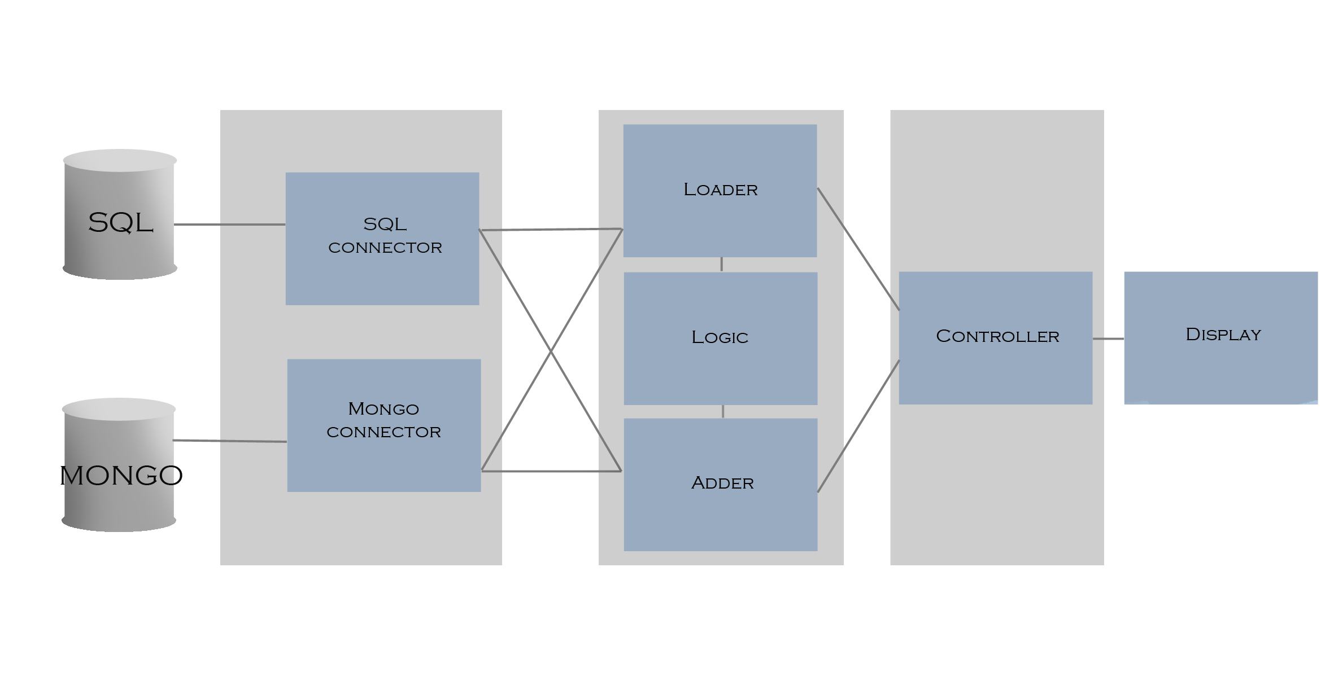
Data/Service/Presentation Diagram

Slide 11
Implementation

Slide 12

System Security
Password Encryption
Desktop App
Encryption Class
Through SQL
SHA1() Function

Slide 13

MySQL Database
Connection
Java
CRUD
Create
Read
Update
Delete

Slide 14

mongoDB
Connection
Java
CRUD
Create
Read
Update
Delete

Slide 15



Website Functionality
Cookies
JavaScript
Thymeleaf
Controllers

Slide 16

More Website Functionality
Loading Information
Sessions
Search

Slide 17

JMS: Java Message Service
Core Backend
Handles Communication between programs
Interrupts all current clients

Slide 18
Live Demo
Java Desktop App & HTML Web App

Slide 19
Questions?

